Slide 1
Why polymer theory is beautiful (and why you should care)
Takashi Yokokura
CBE Student Colloquium
04/27/2023

Slide 2
What is beauty (in physics)?
Before today:
Blue butterfly <--> microscopic patterns
CRISPR, radiation, quantum
Traditional beauty and its underlying mechanisms
Civilizational triumphs in fundamental breakthroughs
After today:
Gauss’s Law, Navier-Stokes, Poisson-Boltzmann
Better understanding of the world around us
Systematic approach to solving engineering problems
Abstracting complex phenomena into mathematical models

Slide 3
The (beautiful) math of polymers
2D Gaussian chain derivation:
Lattice
“Sticks” = grouped chemical monomers
Effect of connectivity on physics
Math (how much?)
A highly simplified model can _____

Slide 4
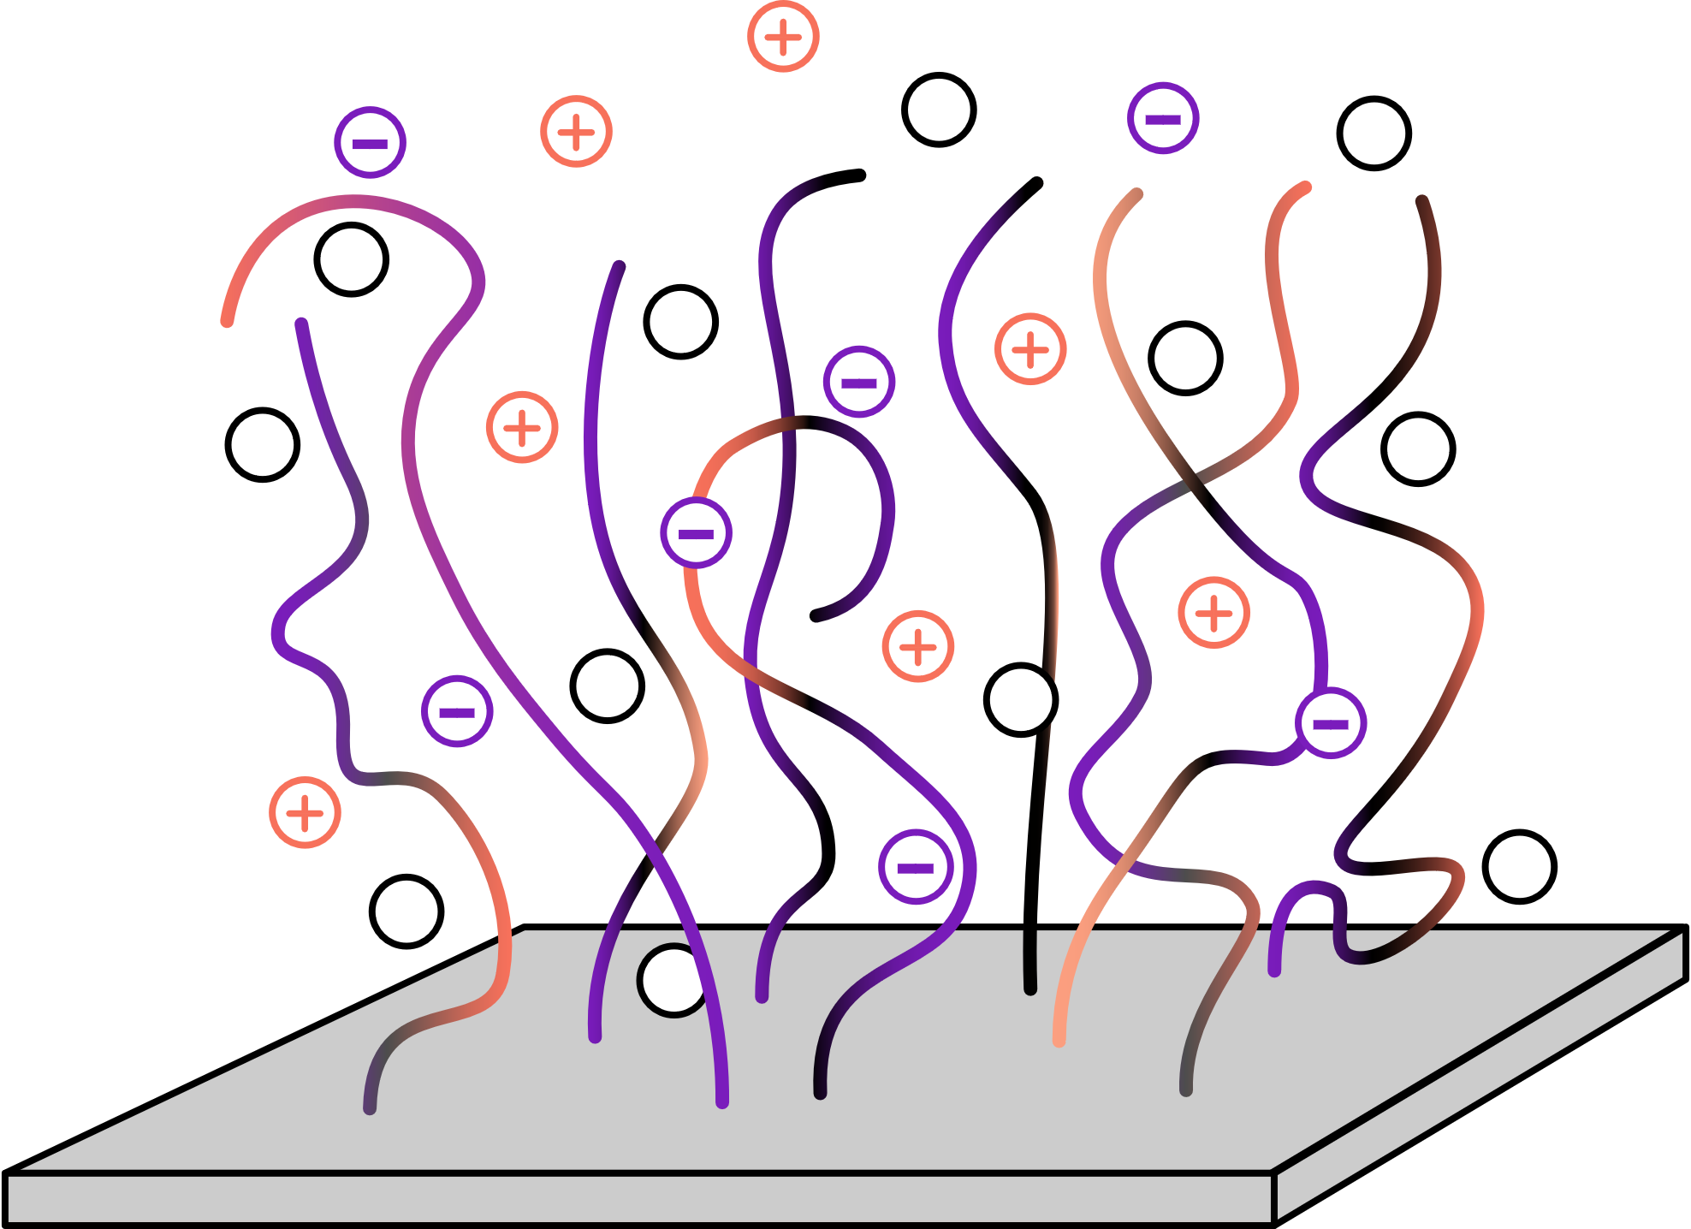
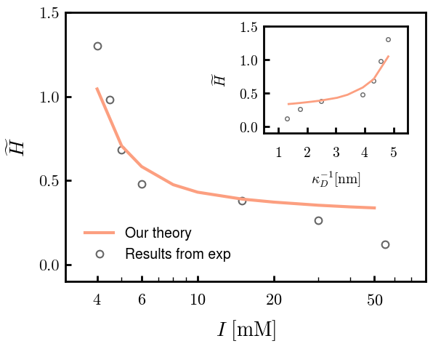
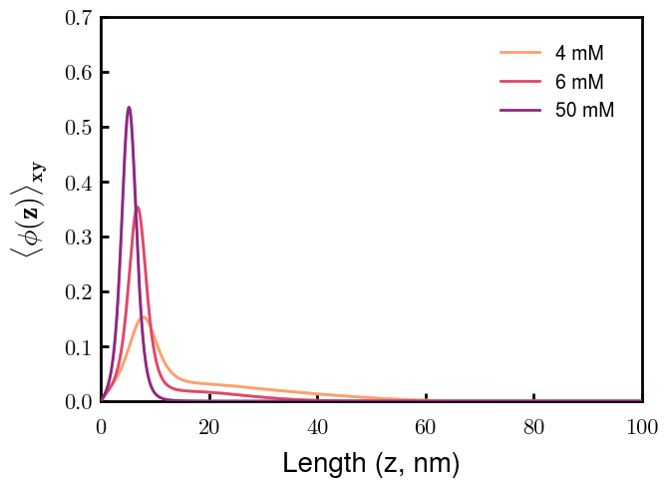
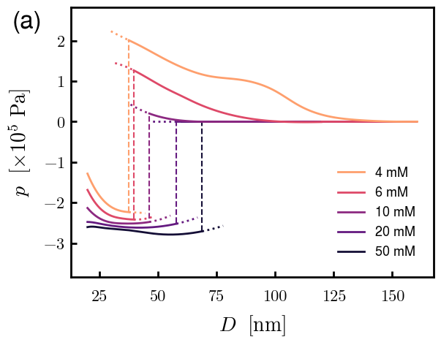

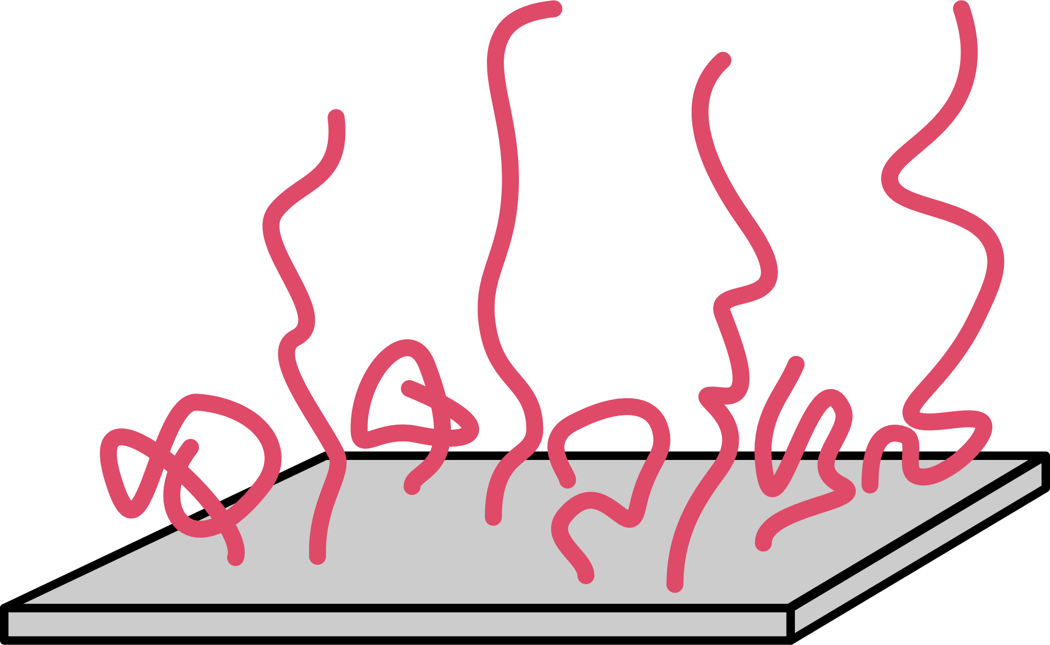
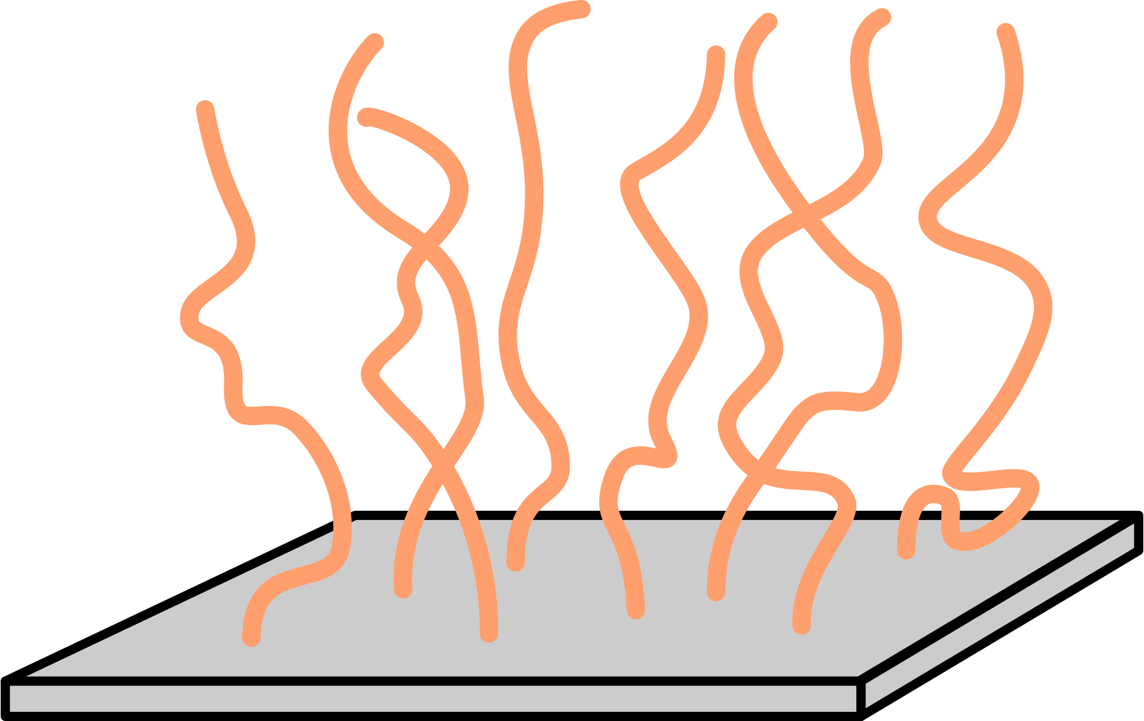
With a little more sophistication, theory can be a powerful, relevant tool
Consider Gaussian chain attached to substrate (brush), polymer-solvent interactions (FH), and polymer-ion electrostatic interactions
Experimental comparison
Polymer organization
Spectra predictions
I
More importantly,

Slide 5
Other (beautiful?) applications of our theory
Vesicle fission by topology
Aggregation
Something about NLH?

Slide 6
Thank you!

Slide 7
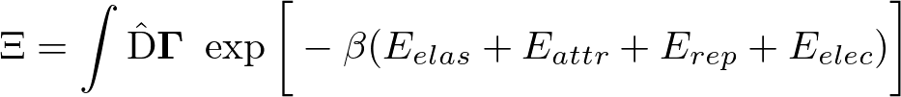
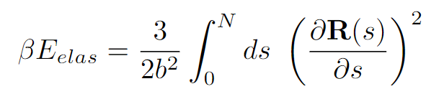
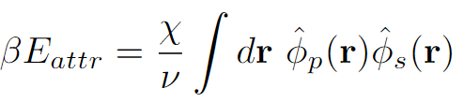
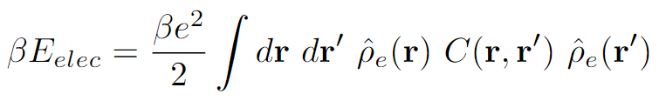

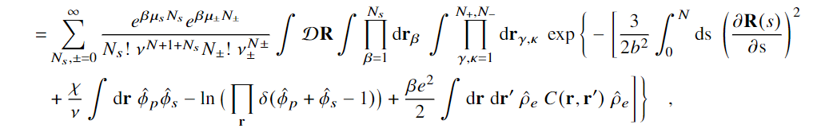
Partition Function Formulation
+
s
s
-
Elastic entropy following Gaussian statistics
+
-
+
s
s
Flory-Huggins short-range interactions
s
-
+
+
+
+
+
+
+
+
+
s
-
s
+
Electrostatic correlations
-
+
s
s
-
Local incompressibility
s
+
+
s

Slide 8

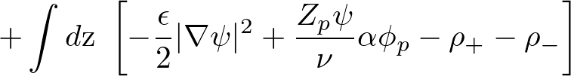

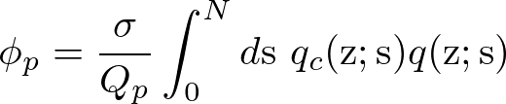
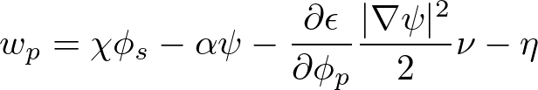
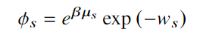


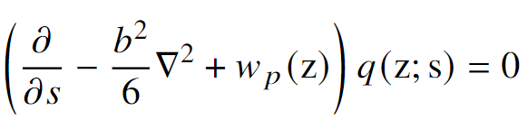
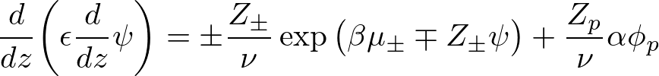



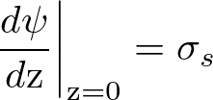

Free Energy and SCF Equations
Free Energy (ensemble average across surface)
Functional Minimization
Polymer Density:
Polymer-controlling Field:
Solvent Density:
Solvent-controlling Field:
Incompressibility:
Monomer Probability:
Electrostatic Potential:

